Slide 1
SPACE
Strange but (probably) true facts
Arthur Pinchbeck – Class 5

Slide 2
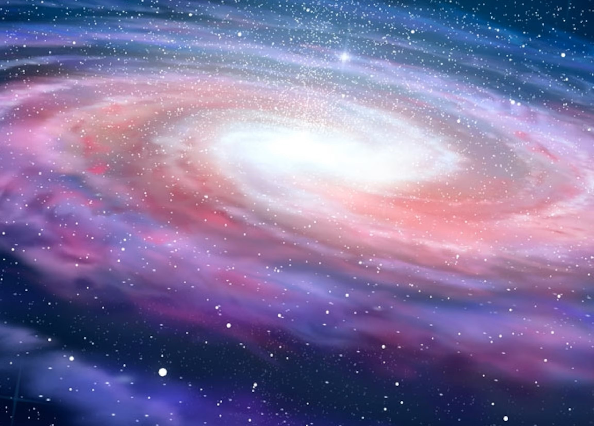
There are more Trees on Earth than Stars in our Milky Way Galaxy.
Stars = 100 to 400 billion
Trees = over 3 Trillion!

Slide 3
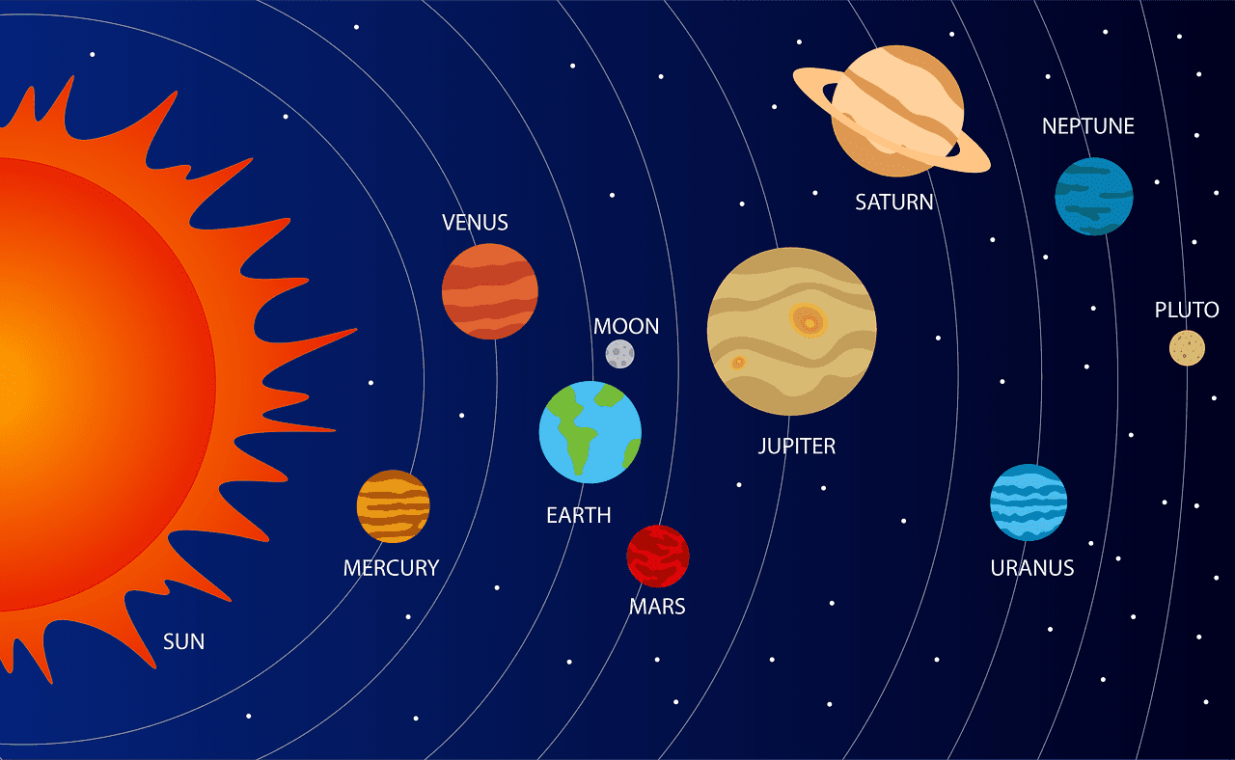
Since humans began exploring space over 60 years ago, Spacecraft has visited all planets in our solar system….even the dwarf planets!
Over this time they have collected endless scientific data and photographs.
Spacecraft = includes Probes and other non-manned craft

Slide 4
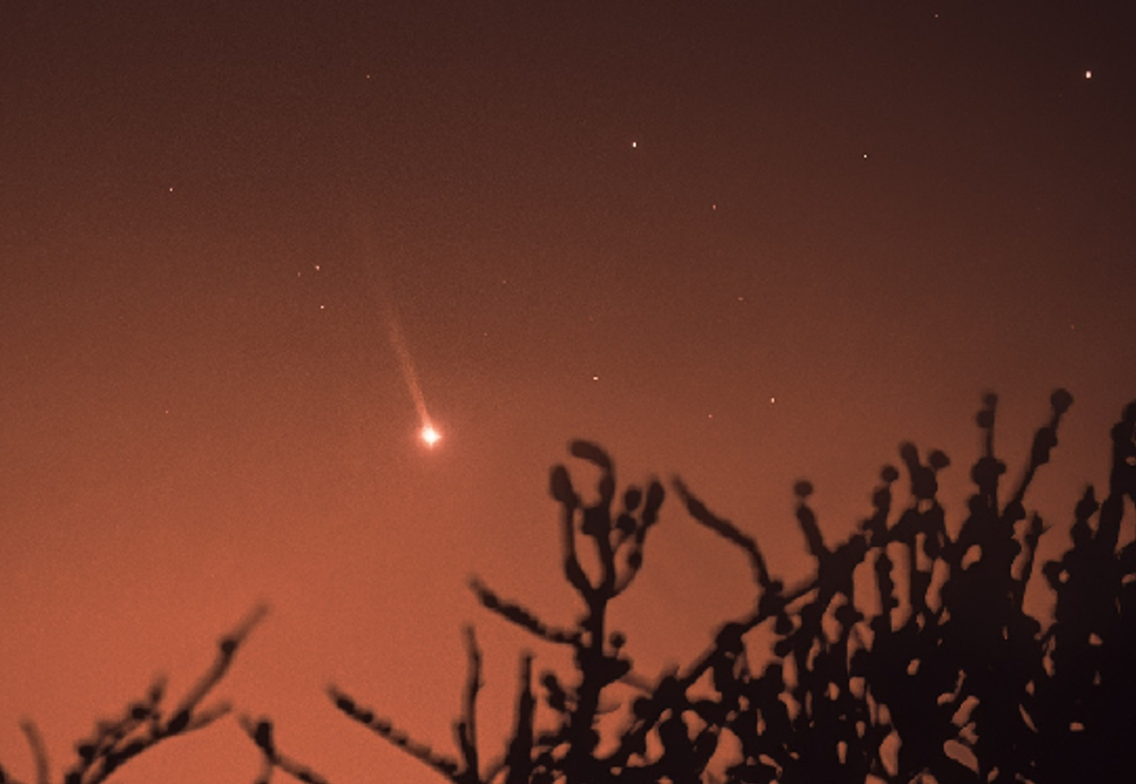
Mercury has a Tail!
It can’t be seen by the naked eye – you’ll need a telescope with special filter.

Slide 5
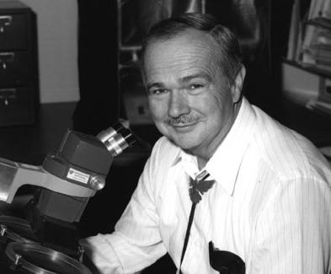

A man has been buried on the Moon!
Eugene Shoemaker’s ashes were taken to the Moon on the Prospector Orbiter in honour of his contribution to planetary science.
Eugene Shoemaker

Slide 6
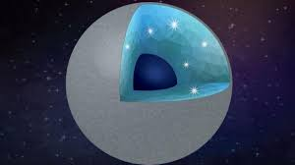
Scientists believe there is a planet likely made of Diamonds! A mere 40 lightyears away!
Well, about a 1/3rd of planet’s mass is thought to be diamond.

Slide 7
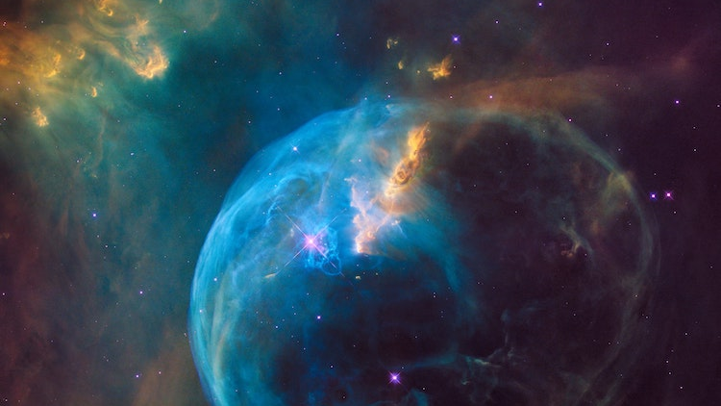
Europa, one of Jupiter’s moons, is thought to contain an Ocean with twice the volume of water on Earth!

Slide 8
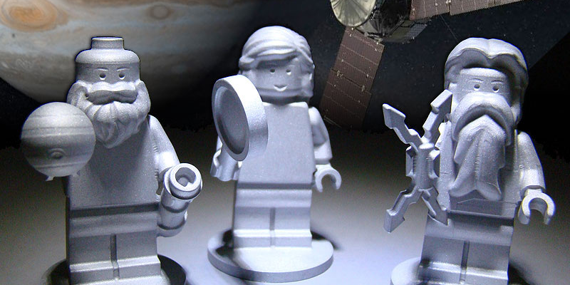
There is Lego in space!
Three figures were created and sent to explore Jupiter to get children interested into space and science

Slide 9
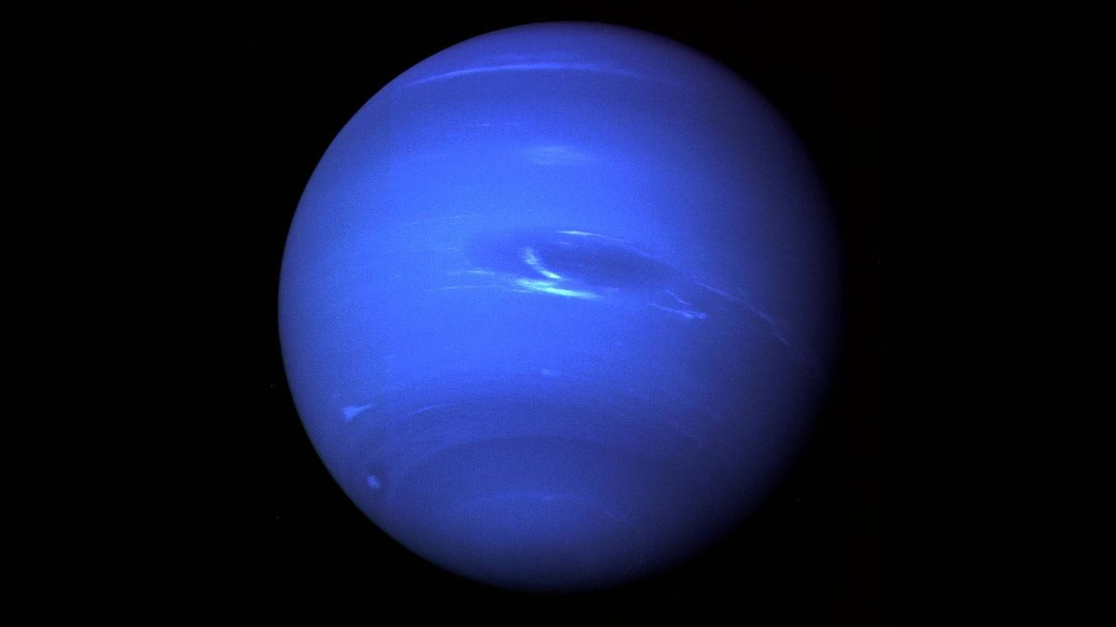
Neptune, the 8th planet from the Sun, has only orbited the sun once since it was discovered in 1846!
Each year on Neptune lasts 164.8 Earth years!

Slide 10
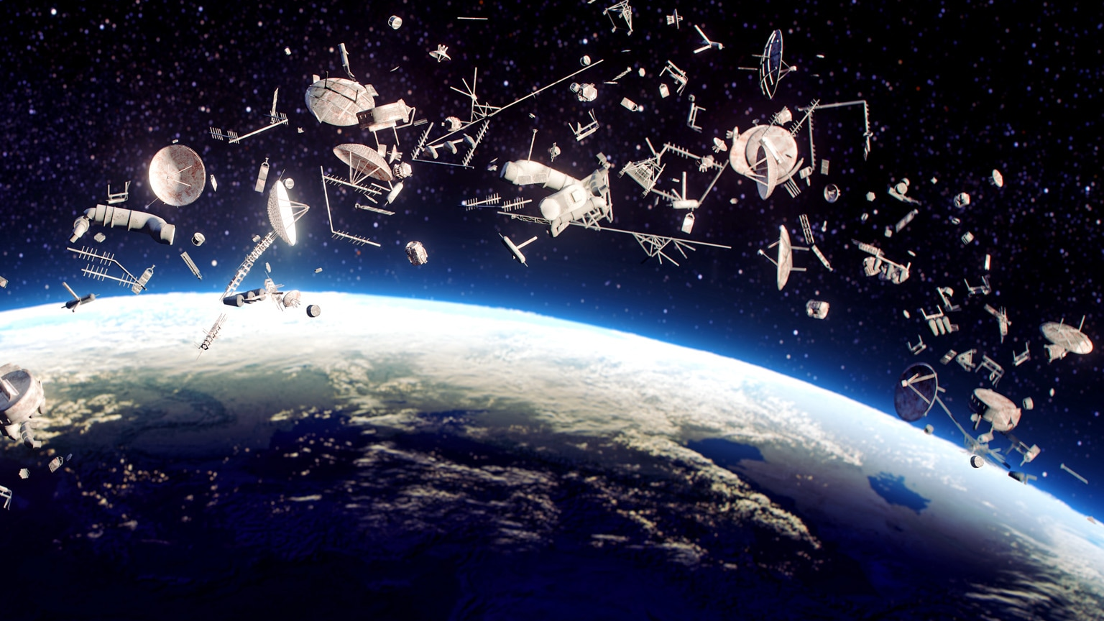
Spacejunk is human made object orbiting the Earth. It is thought
thereare ½ million pieces of junk in Space.

Slide 11
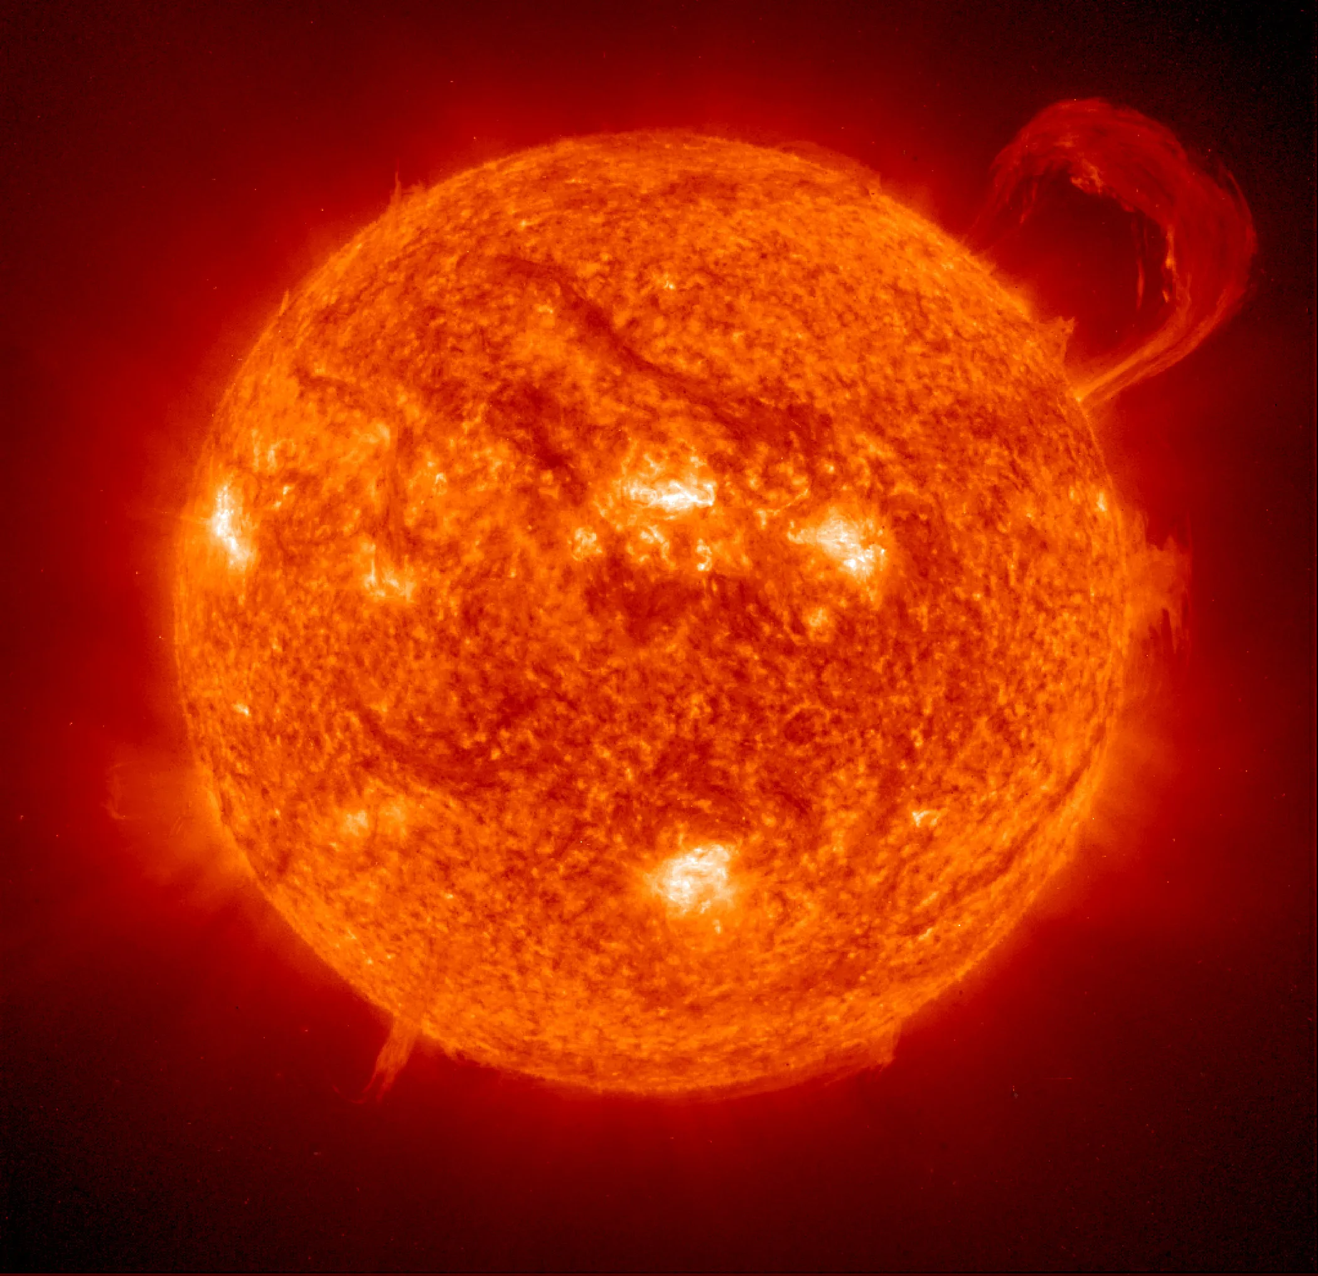
One million Earths could fit inside the Sun,
and the Sun is considered an average-size star!

