Slide 1
Ten Facts about space
By Thomas Burton

Slide 2
Sound of silence!
In space there are no particles so there are no sound waves…..everything is silent!
It is called a vacuum

Slide 3
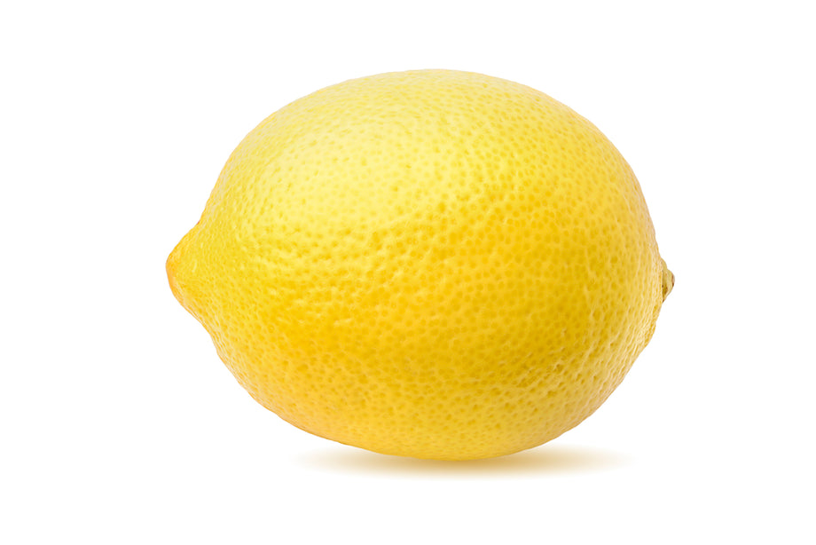
The moon is a lemon!
The moon is actually not round! It is the shape of a lemon or rugby ball.

Slide 4
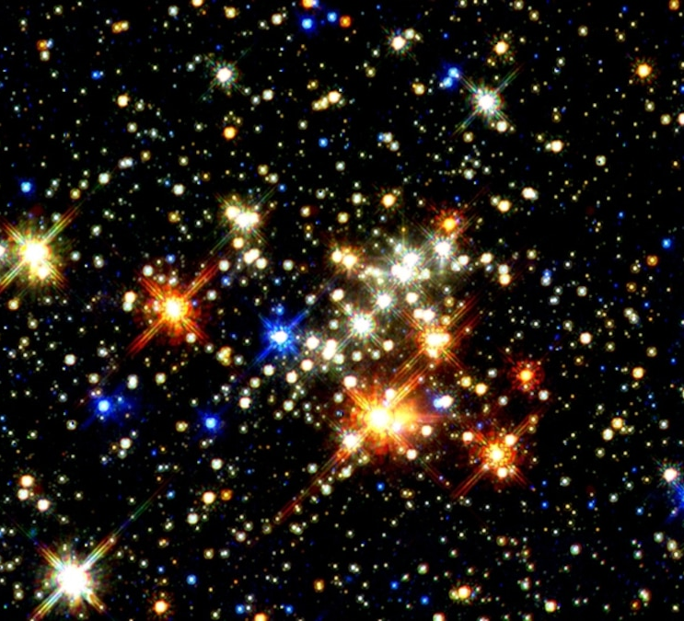
Invisible stars
The first ever stars to form the Universe are now too far away for us to see…..that’s how big the Universe is!

Slide 5
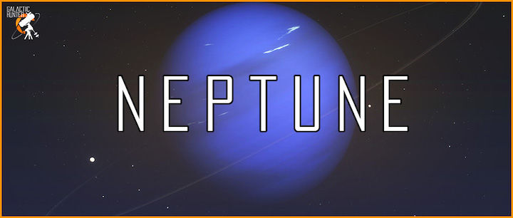
Single orbit neptune
Since 1846 when Neptune was discovered, it has only orbited the Sun once. This happened in 2011 when I wasnn’t even born yet!

Slide 6
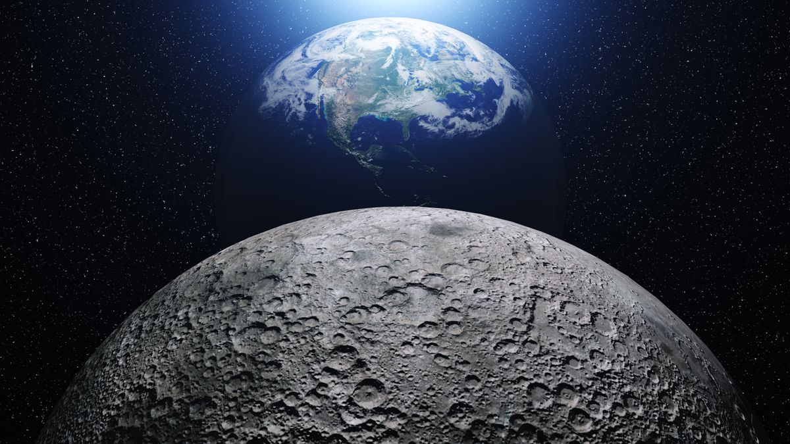
Bye Bye Moon ☹
The moon is moving away from Earth by 3.8cms every year.

Slide 7
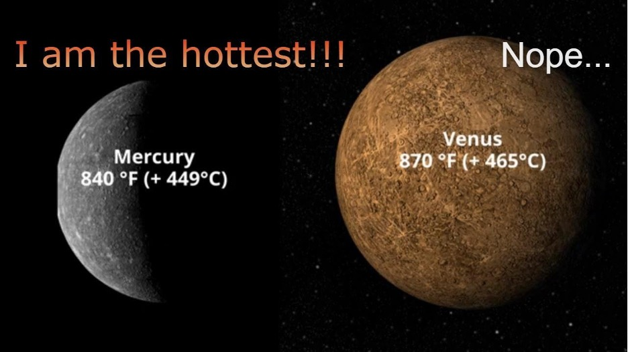
Hot hot planet
Venus is 450ºC….really really hot! To help you understand how hot, water boil ay 100ºC! So water would immediately evaporate.

Slide 8
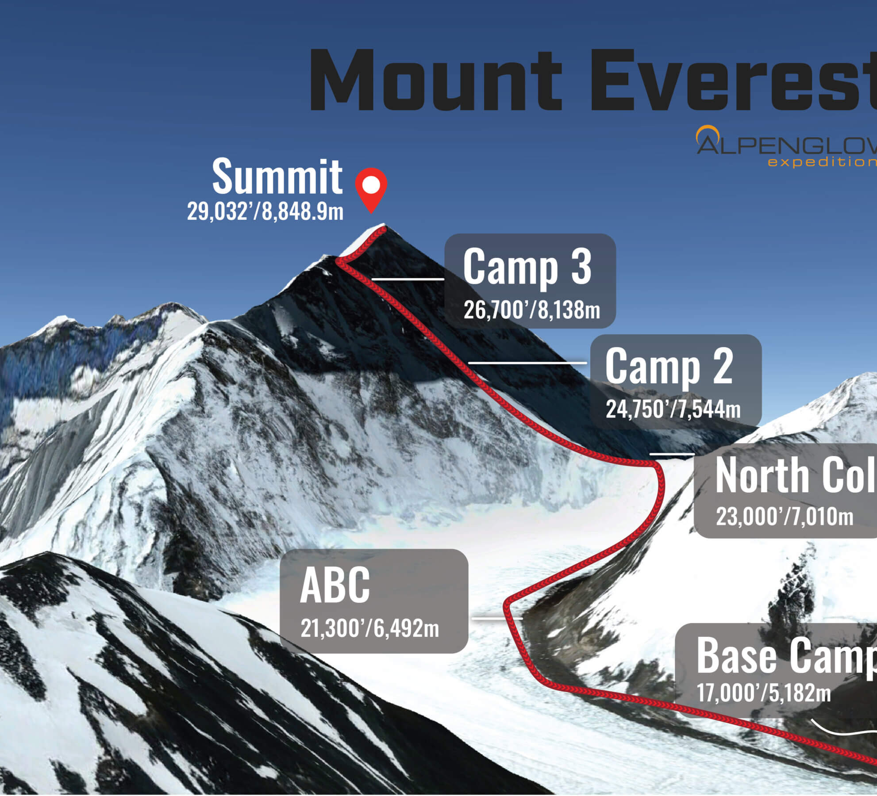
Everest vs. Mars
There is a volcano on Mars that is 3 times the sixe of the tallest mountain in Eart, Everest.

Slide 9
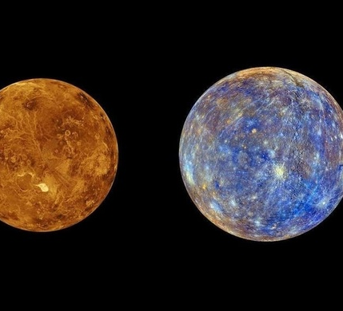
No moons
Mercury and Venus are the only 2 planets that do not have their own moons ☹

Slide 10
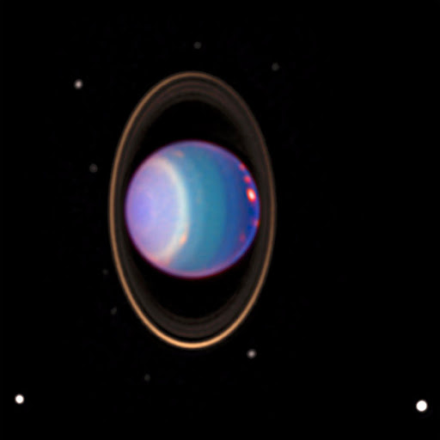
Sideways planet
Uranus orbits on its side.

Slide 11
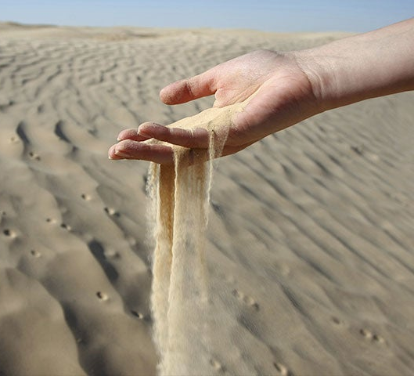
Sand vs. stars
There are more stars in the universe than grains of sand on Earth.

