Slide 1
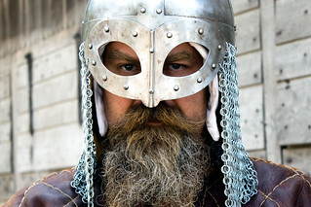
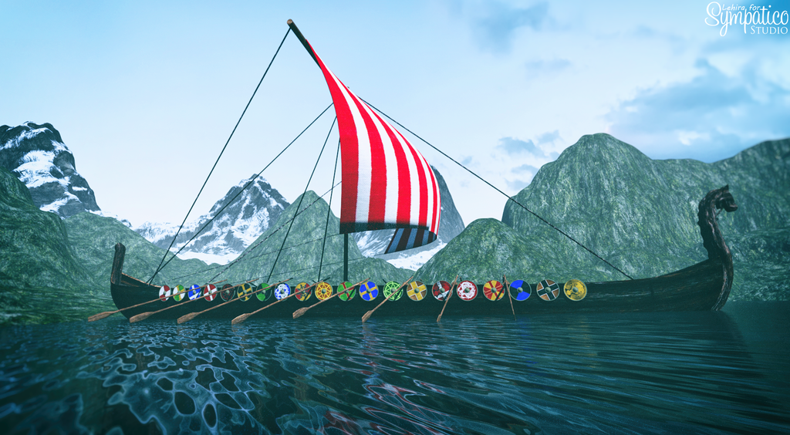
10 things you need to know about Vikings!
By Harry Smith
By Harry Smith

Slide 2
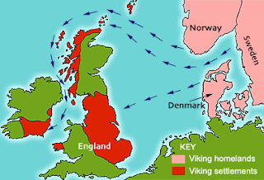
1. Norsemen from Scandinavia
The Vikings were also called Norsemen and came from Scandinavia (which includes Denmark, Sweden, Finland, Iceland and Norway).

Slide 3
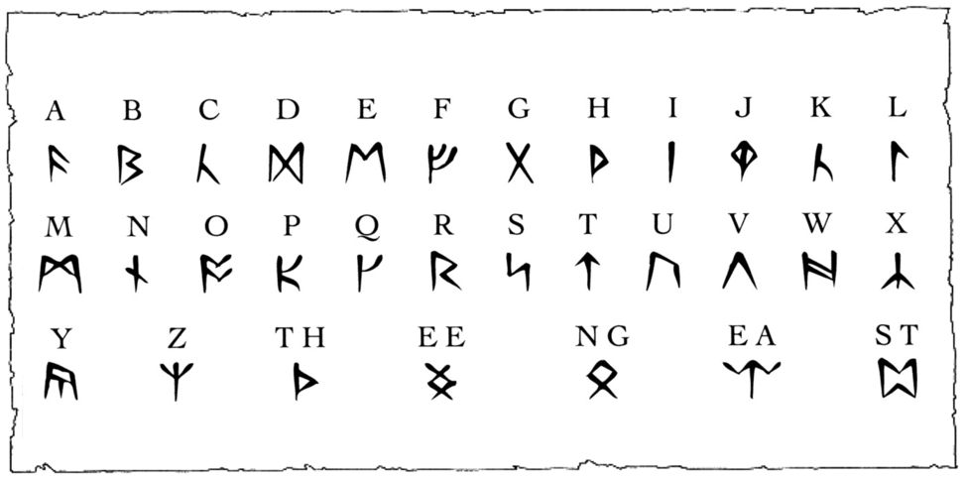
2. Norse was their language
The Vikings spoke Norse, which had an alphabet made up of characters called RUNES.

Slide 4
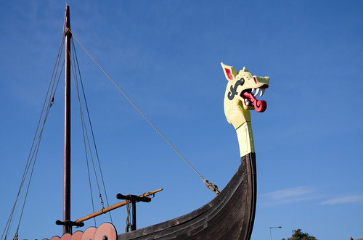
3. LOngships
Vikings travelled across the sea in LONGSHIPS, which are long, narrow wooden boats that could be sailed in both deep and shallow water, using oars.
There is a Viking ship museum in Oslo.

Slide 5
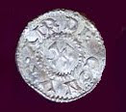
4. Looking for a better life!
The Vikings left their homeland for several reasons……..
1. They were looking for better places to farm than the kind of terrain that Scandinavia had.
2. Some historians say their countries were overpopulated.
3. They were drawn to the riches and trade.

Slide 6

5. Going beserk!
The Vikings first attacked Britain in 787 A.D but didn’t start to invade and settle in the British Isles until 793 A.D.
There was a special group of Viking warriors called beserkers who went into battle without armour and fought in a trance-like fury, howling like wolves and dogs. This is where the saying “going beserk” comes from.
Berserkers - VIKING | WAR MUSIC (youtube.com)

Slide 7
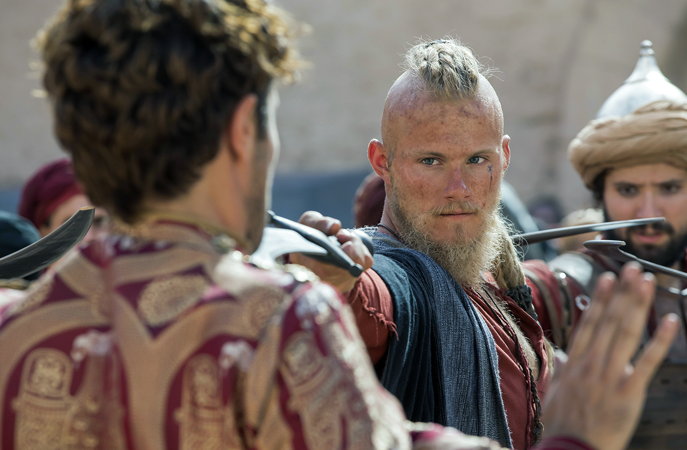
6. Blonde is better!
Viking men preferred to be blonde. Dark-haired Vikings used a special soap to dye their hair and beards to lighten them.

Slide 8
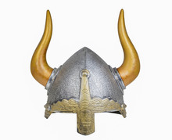
7. Horned helmets – True or false?
FALSE!
The Vikings didn’t wear horned helmets. Popular culture often portrays Vikings wearing helmets with horns, but there is no evidence to show that this was true.

Slide 9

8. valhalla
Viking warriors believed that when they died in battle they went to VALHALLA where the king of the gods lived named Odin.
They were often laid to rest in boats.
VALHALLA CALLING by Miracle Of Sound - ORIGINAL VERSION (Viking/Nordic-inspired Dark Folk Music) - YouTube

Slide 10
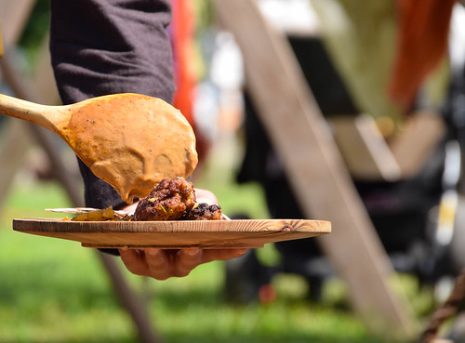
9. What’s on the menu?
The Vikings only ate twice a day.
They would have a meal soon after getting up called “Dagmal” (day meal) and a meal in the evening called “nattmal” (night meal).
They were known to be greedy, needing energy rich fatty foods, particularly in the winter months. They also enjoyed sweet foods like honey and fruit.

Slide 11
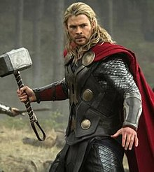
10. Days of the week.
Did you know that the days of the week have Viking origins?
The Norse gods and goddesses influenced the way we name our days.
MONDAY – Moon’s Day
TUESDAY – Tyr’s Day
WEDNESDAY – Odin’s Day
THURSDAY – Thor’s Day
FRIDAY – Frigg’s Day
SATURDAY – Saturn’s Day
SUNDAY – Sun’s Day

Slide 12
Thanks for listening

