Slide 1
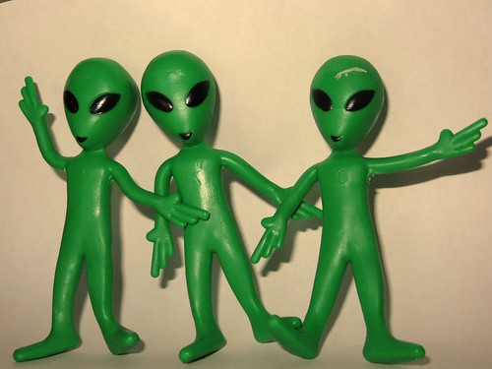
Max’s earth & space Quiz

Slide 2
1. How many people are on earth? a. 8 billion b. 6 billion c. 5 billion

Slide 3
There are 8 billion

Slide 4
2. Is space silent a. yes b. no

Slide 5
Space is silent

Slide 6
3. What is the hottest planet a. venus b.sun c. moon

Slide 7
Venus is the hottest planet the sun is not a planet it is a star

Slide 8
4. What is the closet planet to the sun a. moon b.mercury c. venus

Slide 9
It is mercury

Slide 10
5. How many stars are in space a. none b. 8 billion c. 1 million

Slide 11
It was a trick no one knows

Slide 12
6. A full NASA space suit costs $12,000,000 true or false

Slide 13
It is true

Slide 14
7. Neutron stars can spin 600 times per second. True or false

Slide 15
It is true

Slide 16
8. There may be a planet made out of diamonds. A. yes b.no c. maybe

Slide 17
it is c there maybe a planet made out of dimonds

Slide 18
9. The footprints on the Moon will be there for 100 million years. True or false

Slide 19
It is true

Slide 20
10. One day on Venus is longer than one year. True or false

Slide 21
It is true

Slide 22
Made by Max Dennis

