Slide 1
Anglo Saxons
By Thomas Burton

Slide 2
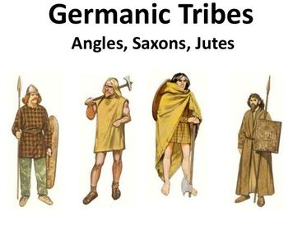
Anglo Saxons were made up from Germanie tribes called Jutes, Angles and Saxons.

Slide 3
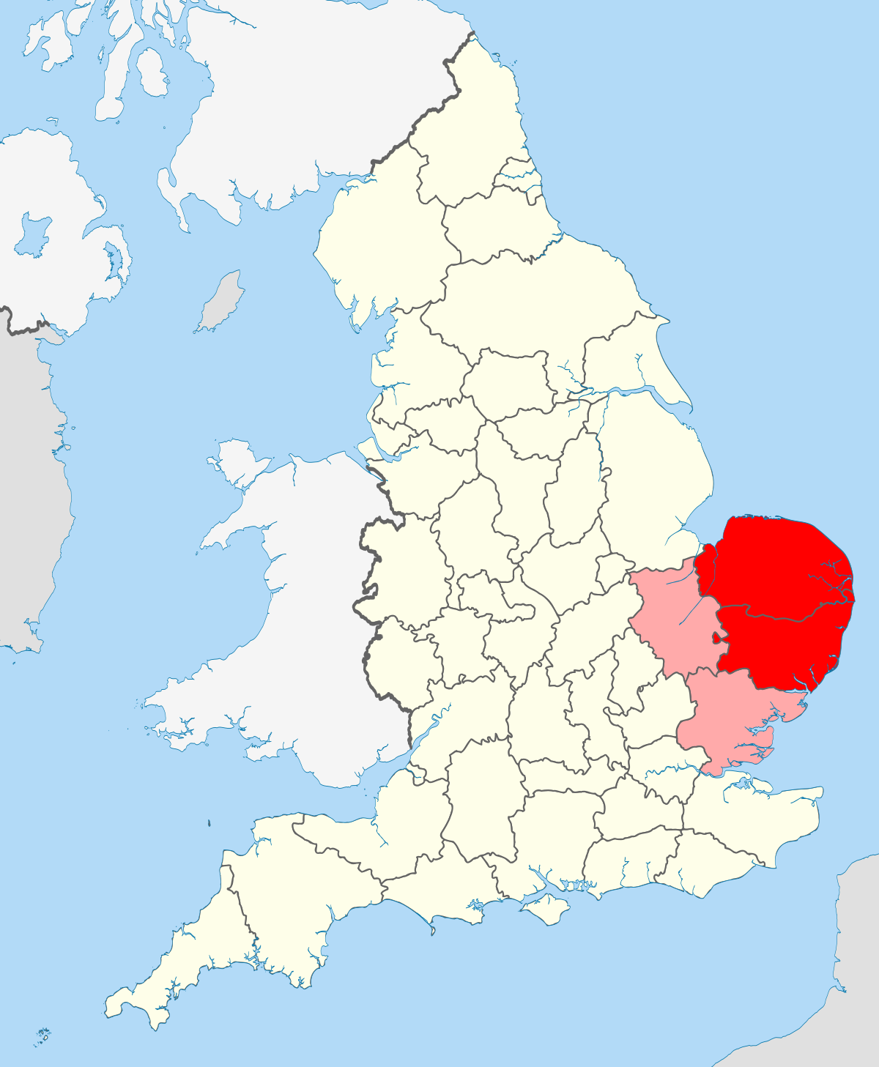
East Anglia’s name comes from the East Angles.

Slide 4
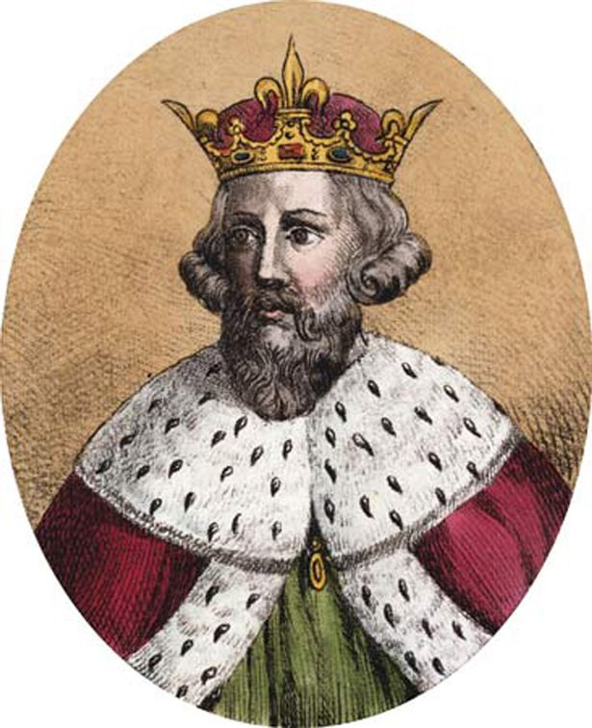
A king of Wessex, Alfred was the only English king to be called ‘The Great’.

Slide 5
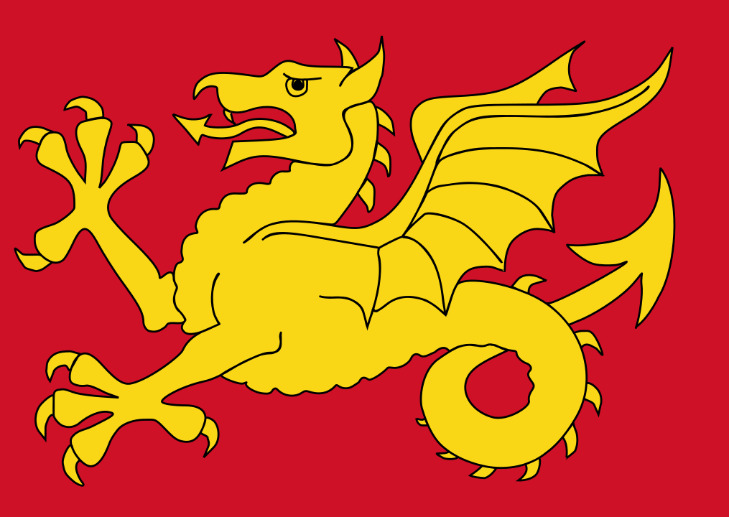
Wessex was the kingdom of the West Saxons.

Slide 6
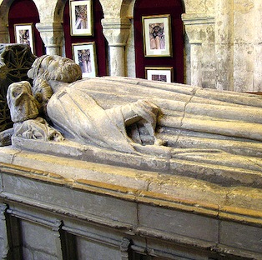
Athelstan was the first king of the English.

Slide 7
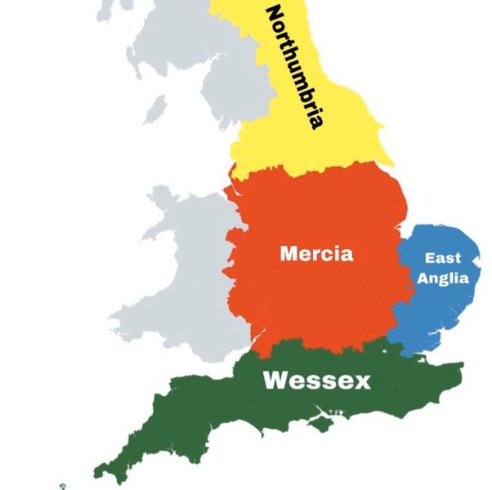
At the time of the Viking invasion there were many Anglo-Saxon kingdoms – Mercia, East Anglia, Wessex, Northumbria.

Slide 8
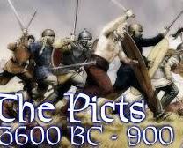
The Picts were Celts.

Slide 9
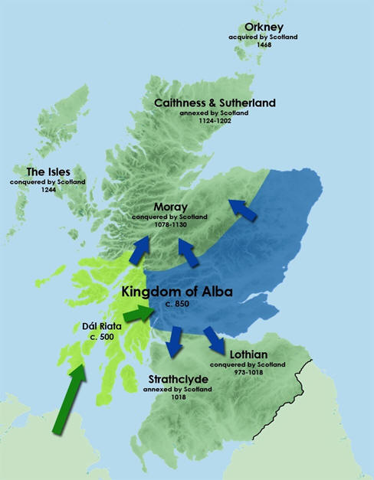
There were several Pictish/Scottish kingdoms, with Strathclyde and Alta being the closest to England.

Slide 10
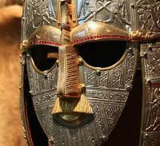
A massive burial site of an Anglo Saxon king was found at Sutton-Hoo in Suffolk.

Slide 11
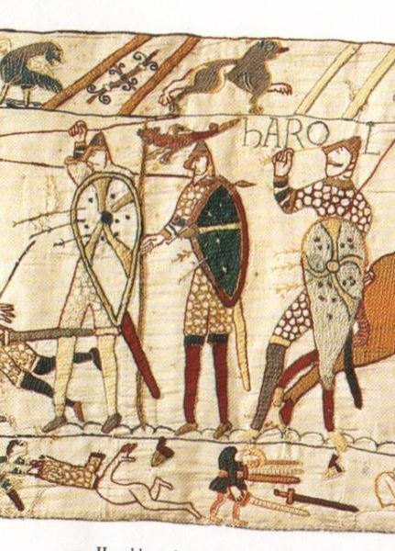
The last Anglo-Saxon king of England was Harold II, killed by the Normans at the Battle of Hastings.

Slide 12
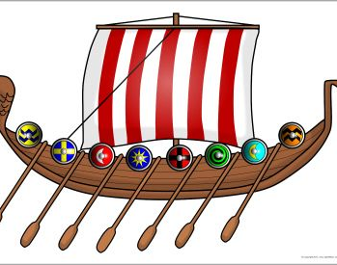
Thank you for watching.

