Slide 1
VIKING VILLAGE
Today you will go back in time to the ancient Viking village Jorvik

Slide 2
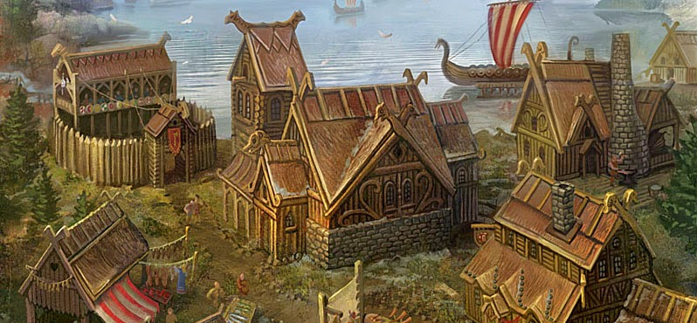
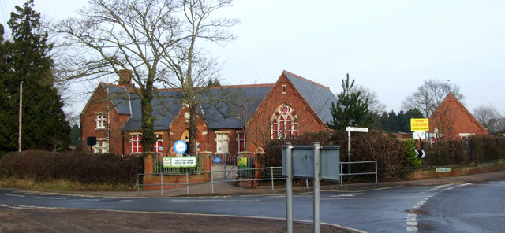

VILLAGES
This Photo by Unknown Author is licensed under CC BY-NC-ND
This Photo by Unknown Author is licensed under CC BY-SA
This Photo by Unknown Author is licensed under CC BY-NC-ND
VIKING
PRESENT DAY
FUTURISTIC
THIS IS A VILLAGE FROM THE PAST
THIS IS A NORMAL VILLAGE IIN 2023
THIS ITS WHAT BLOFIELD COULD ONE DAY LOOK LIKE

Slide 3
Life in Jorvik
Jorvik is a Viking village.

Slide 4
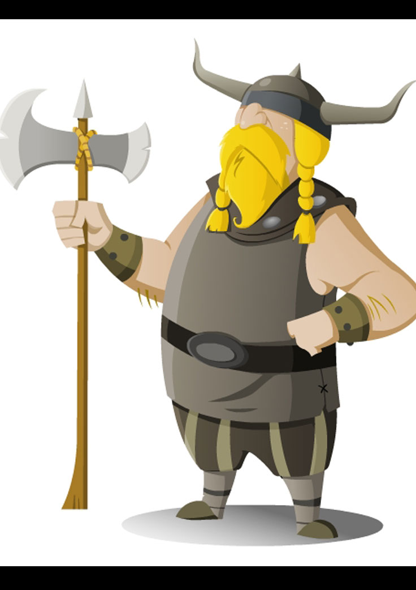
Vikings
The Vikings were a group of people who travelled from Norway to Britannia .although they didn’t call themselves Vikings. Here is a Viking->
This Photo by Unknown Author is licensed under CC BY-NC-ND

Slide 5
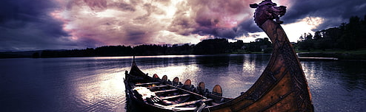
Longboats
Long boats were one of the best ways of travelling in Viking times. They added shields on the sides to protect them.

Slide 6
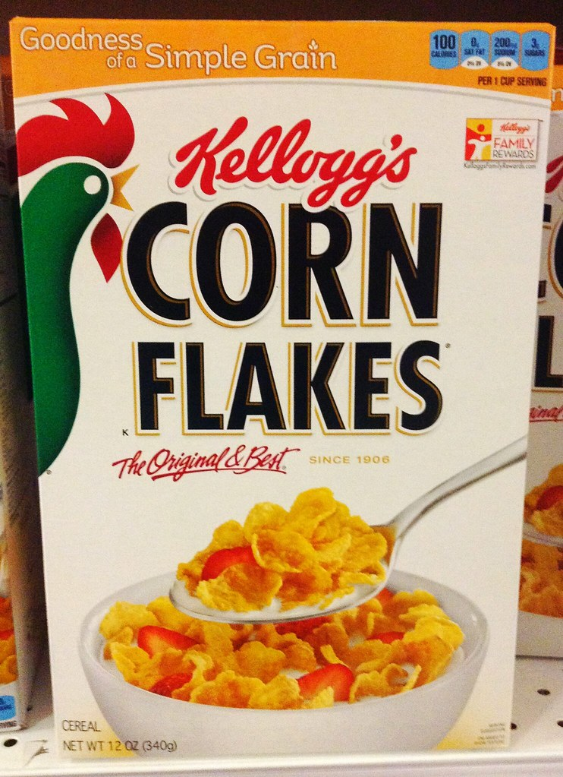
FOOD
VIKINGS HAD A VARIED DIET:MEAT,FISH,VEGETABLES,CEREALS AND MILK.
THEY DID NOT HAVE CORN FLAKES (THE BEST CEREAL)
This Photo by Unknown Author is licensed under CC BY

Slide 7
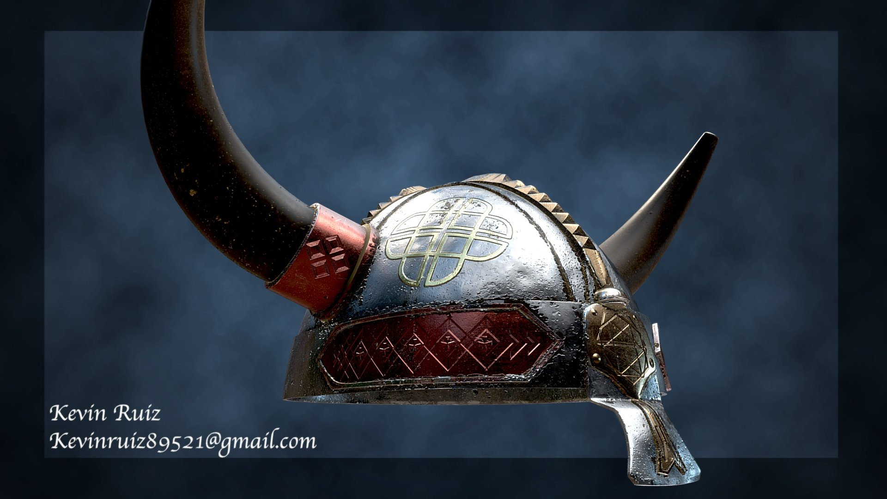
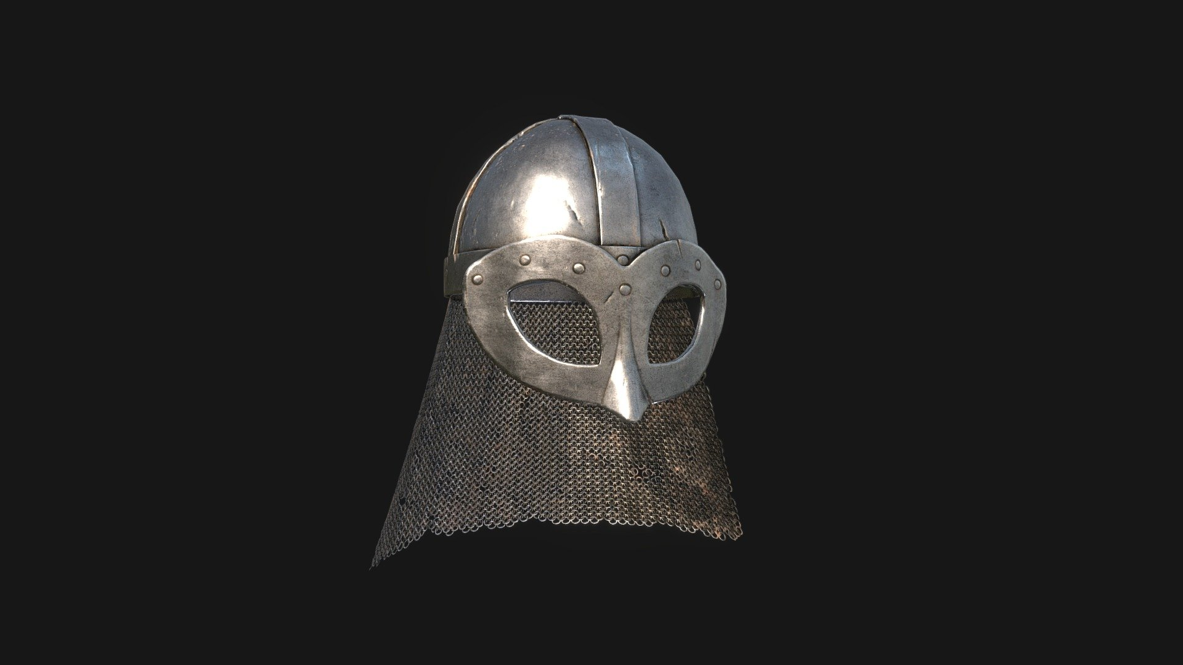
HELMETS
Myth
Real
This Photo by Unknown Author is licensed under CC BY
This Photo by Unknown Author is licensed under CC BY

Slide 8
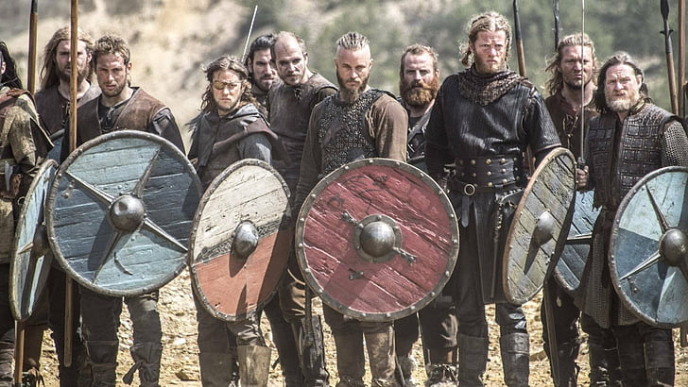
invasion
Vikings invading Norfolk from norway

Slide 9
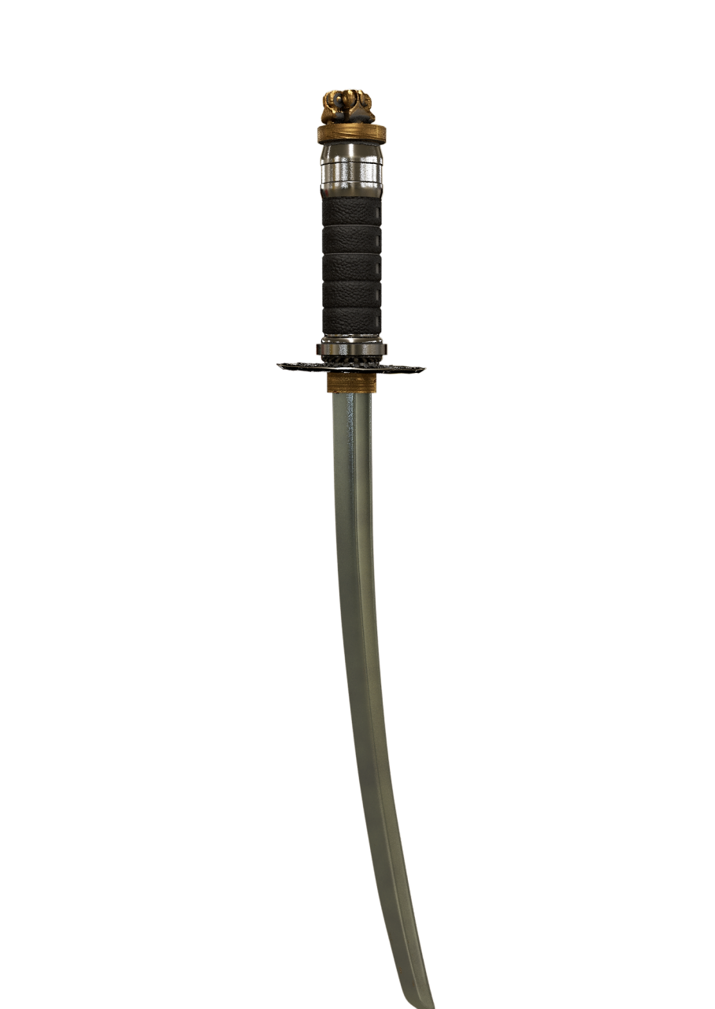
weapons
This a viking longsword. Vikings used multiple weapons such as axes and swords.

Slide 10
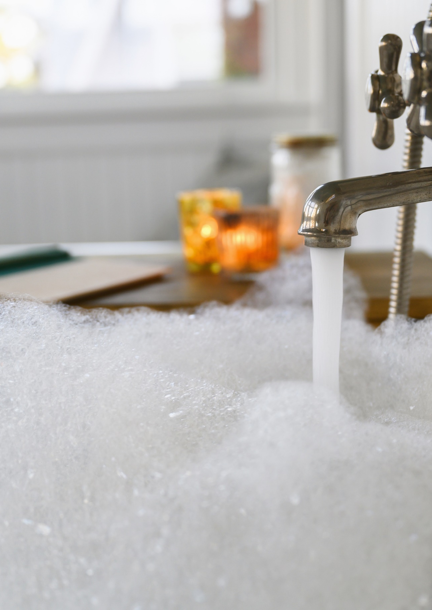
Hygiene
Vikings actually had very good hygiene! They bathed weekly and groomed themselves . They made combs and razors out of animal bones!

Slide 11
QUIZ TIME
LETS SEE HOW MANY FACTS YOU CAN REMEMBER

Slide 12
WHAT DID VIKINGS MAKE BATH TOOLS OUT OF?
ANIMAL BONES

Slide 13
HOW DID VIKINGS GET AROUND?
LONGBOATS

Slide 14
Did viking helmets have horns?
no

Slide 15
What did Vikings eat?
meat ,fish , veg ,cereals and milk

Slide 16
Where did Vikings land?
norfolk

Slide 17

Run away to the library for more viking facts…

